Slide 1
Week 11 Notes
PHY495: Hoop Never Misses

Slide 2
What I’ve Done
Got the ball to register hitting the backboard
Successfully made random 3-point backboards to test different shots off

Slide 3
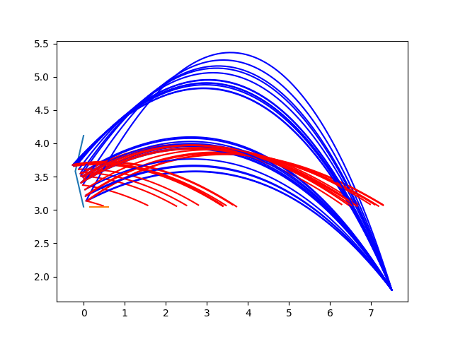
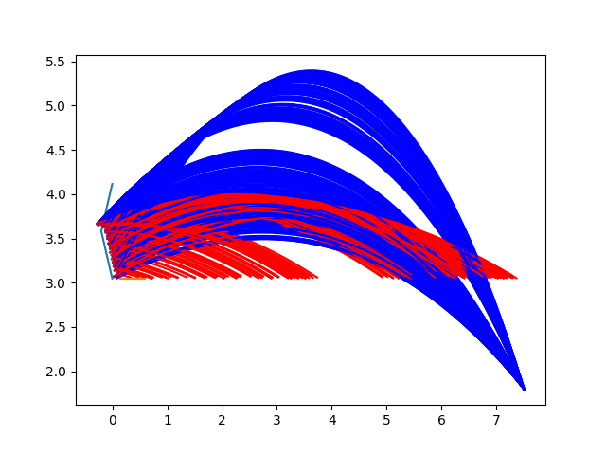
Backboard_y = [0,-0.2,0] (fixed starting position, varying angle)

Slide 4
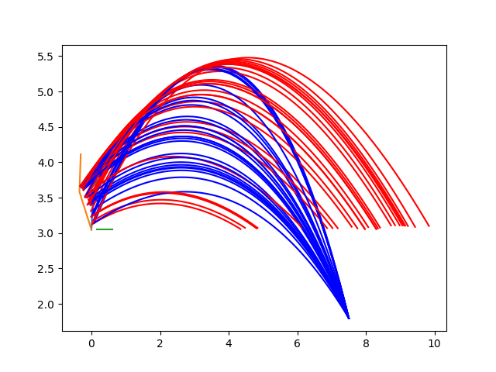
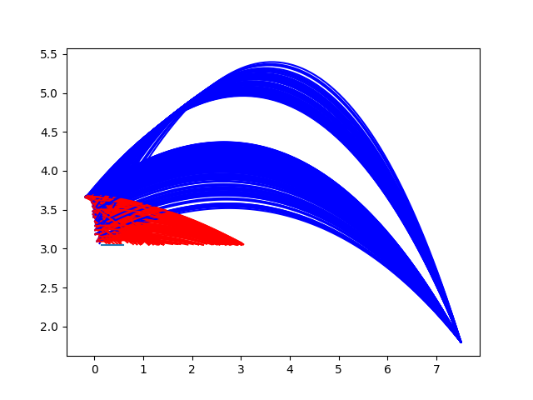
Random backboard (fixed starting position, varying angle)

Slide 5
What Worked
Ball successfully hit off backboard for random initial shots and random backboards

Slide 6
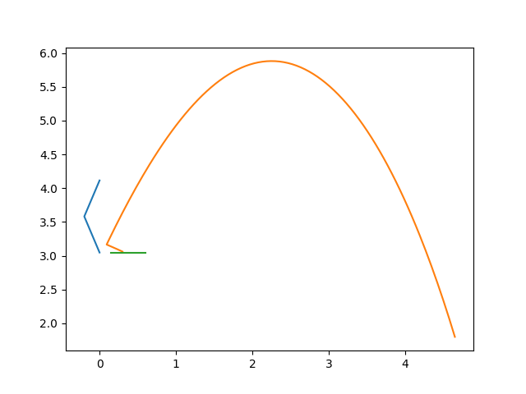
Where I’m Stuck
Ball isn’t registering as going in the hoop
This shot goes in basket but still registers as 0% in

Slide 7
What Next?
Get the basket to work

